Slide 1
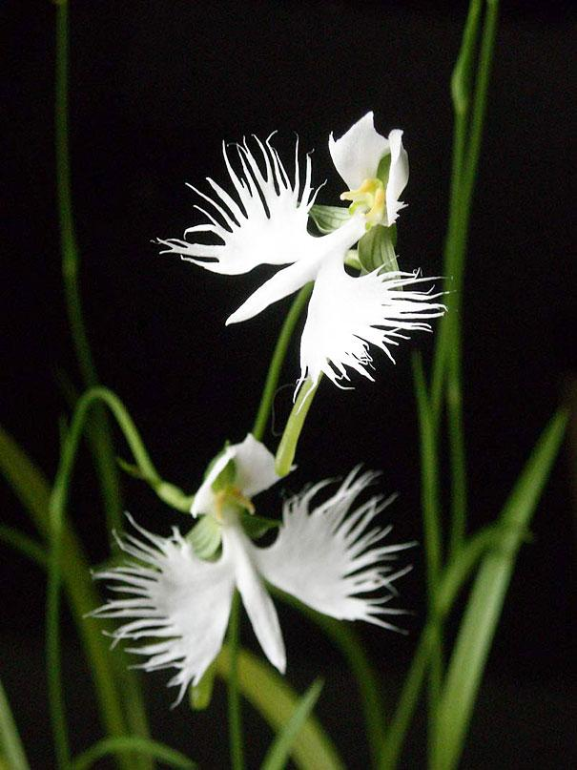
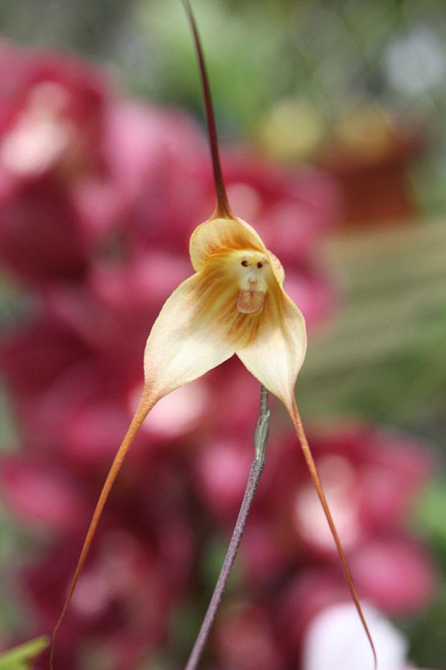
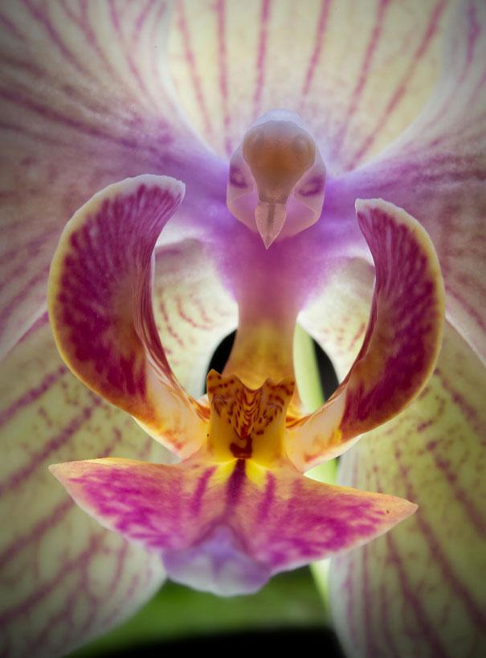
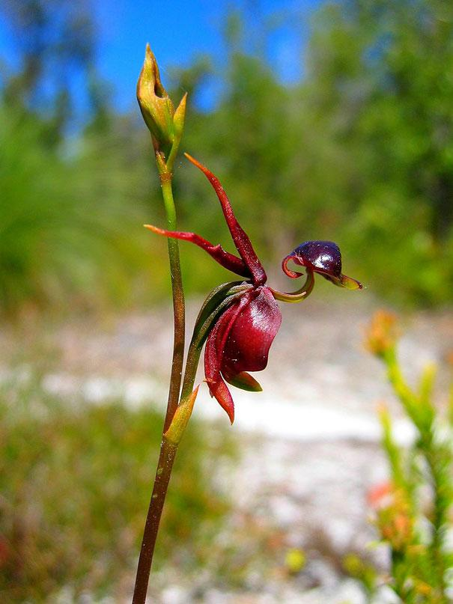
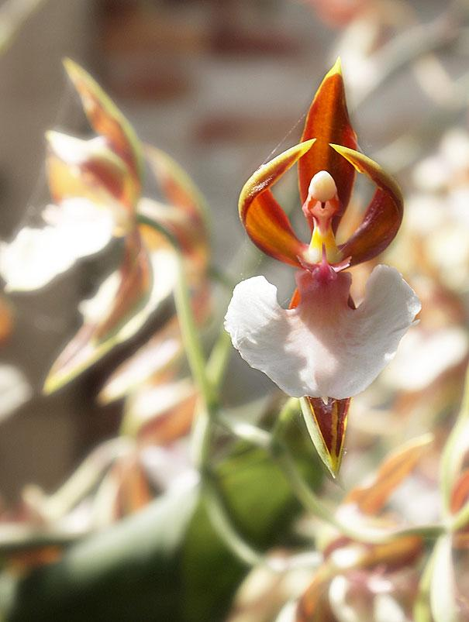
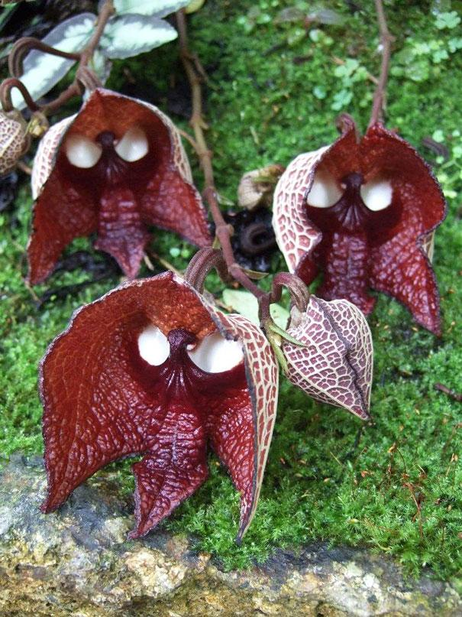
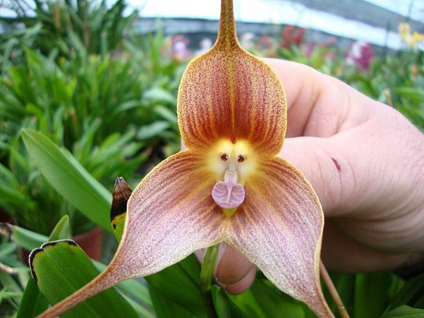
Fantasztikus virágok

Slide 3
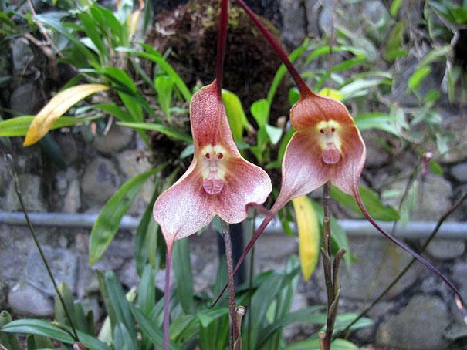
Monkey Face Orchid (Dracula Simia)

Slide 4
Moth Orchid (Phalaenopsis)

Slide 6
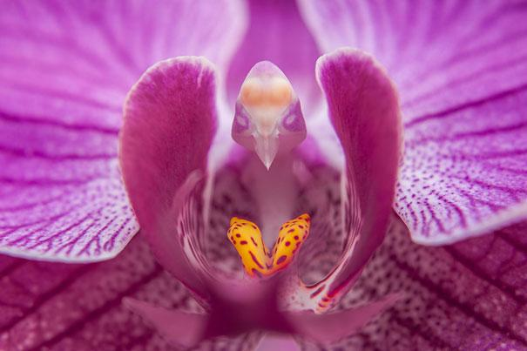

Slide 7
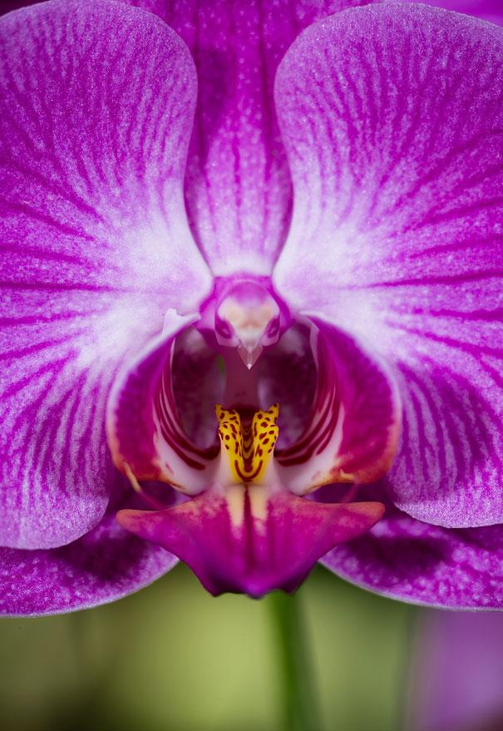

Slide 8
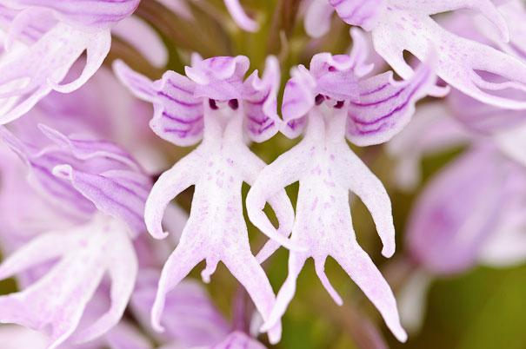
Naked Man Orchid (Orchis Italica)

Slide 9
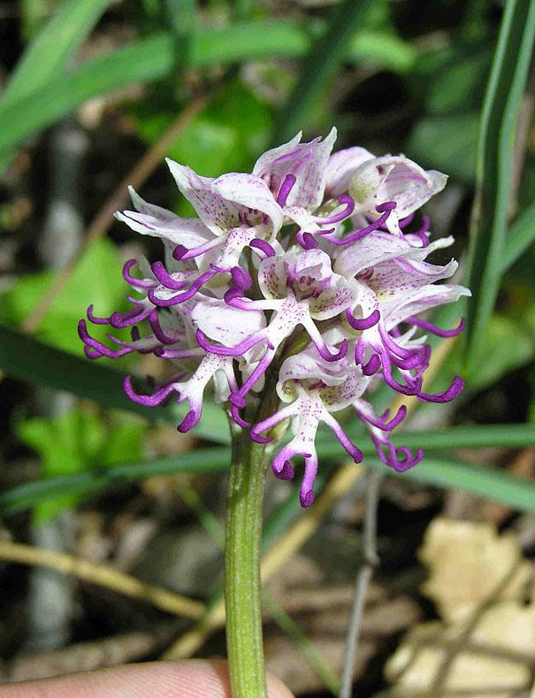

Slide 10
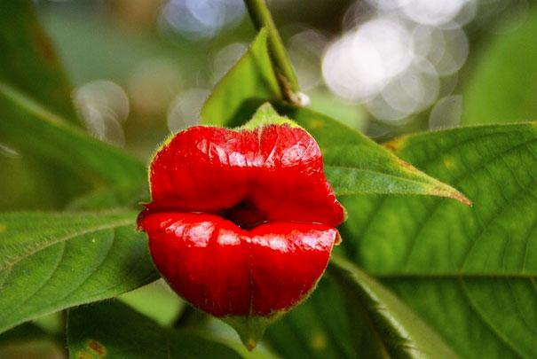
Hooker’s Lips (Psychotria Elata)

Slide 11
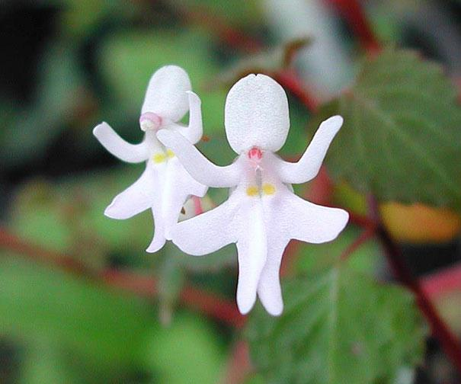
Dancing Girls (Impatiens Bequaertii)

Slide 12
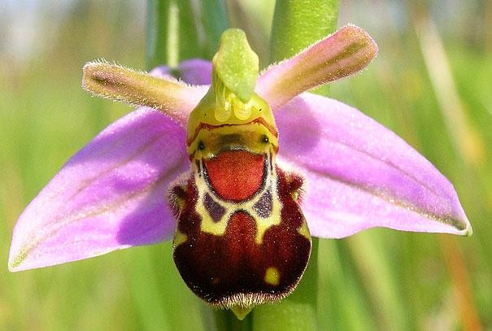
Laughing Bumble Bee Orchid
(Ophrys bomybliflora)

Slide 13
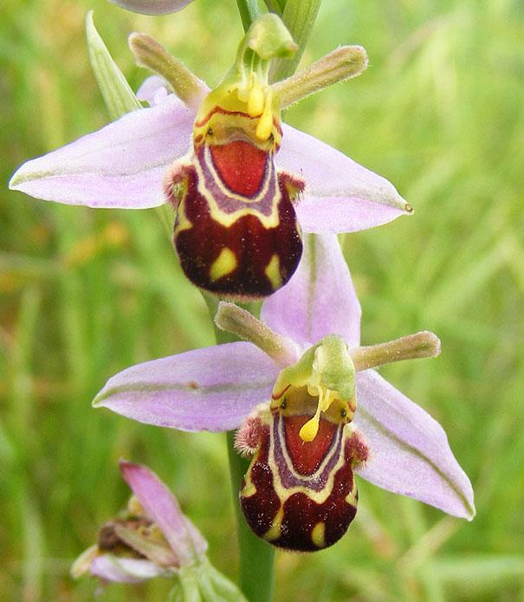

Slide 14
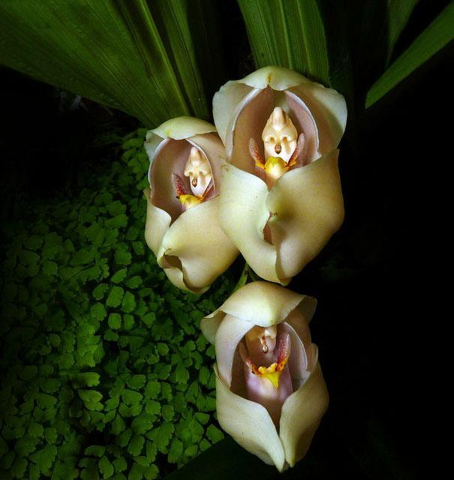
Swaddled Babies (Anguloa Uniflora)

Slide 15
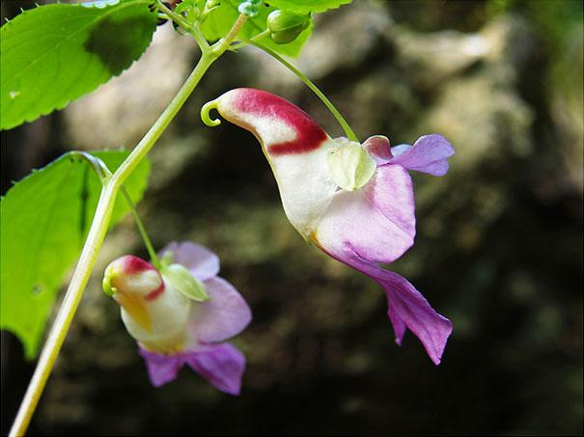
Parrot Flower (Impatiens Psittacina)

Slide 16
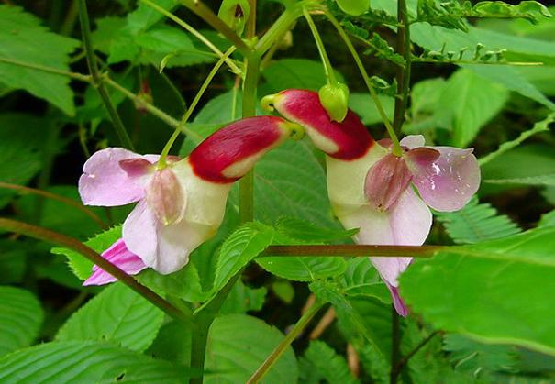

Slide 17
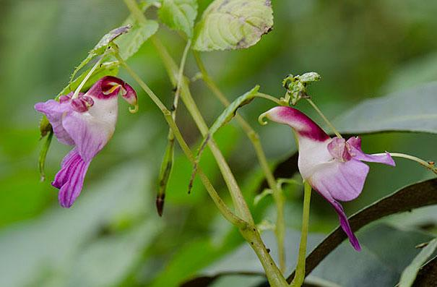

Slide 18
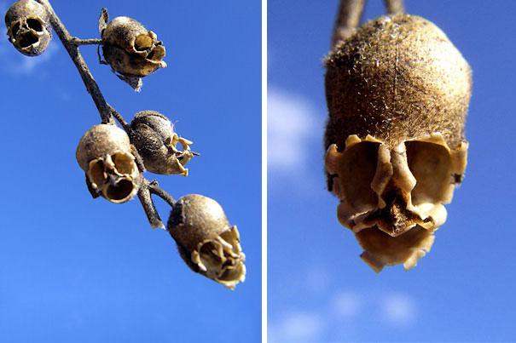
Snap Dragon Seed Pod (Antirrhinum)

Slide 19
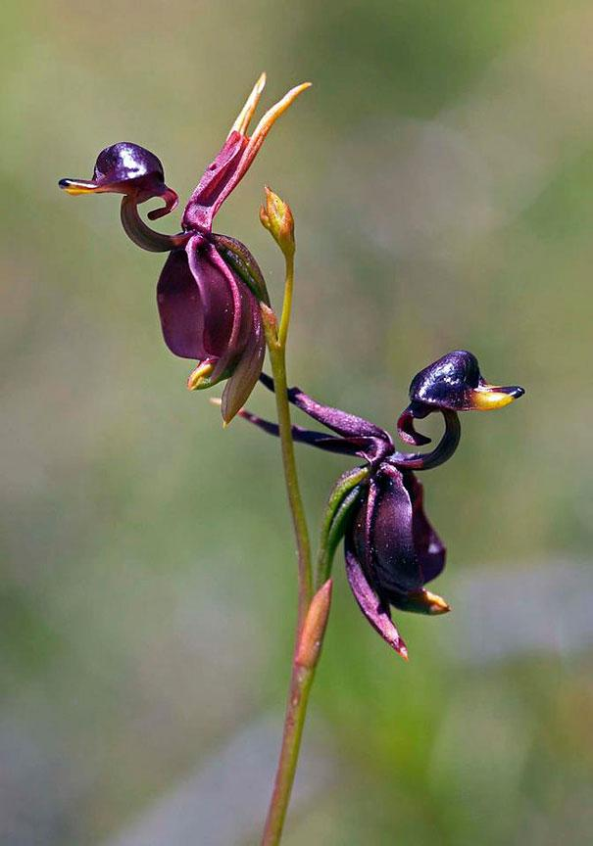
Flying Duck Orchid
(Caleana Major)

Slide 21
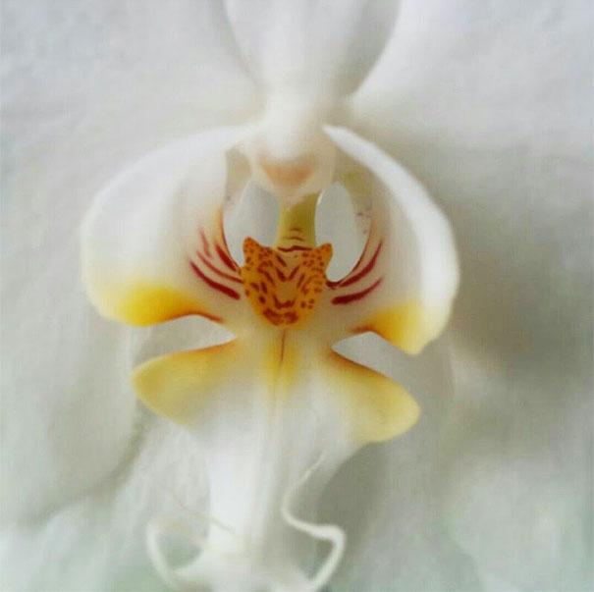
An orchid that looks remarkably like a tiger

Slide 22
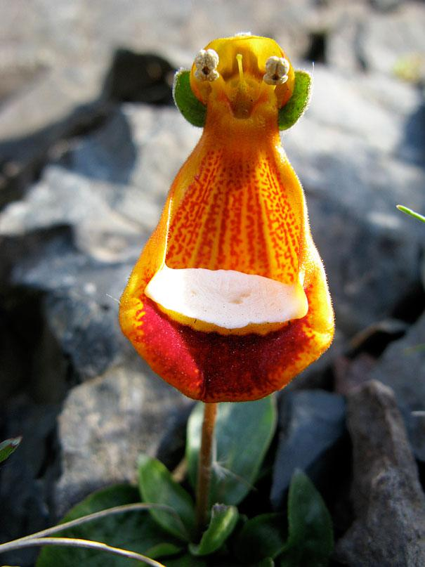
Happy Alien (Calceolaria Uniflora)

Slide 23
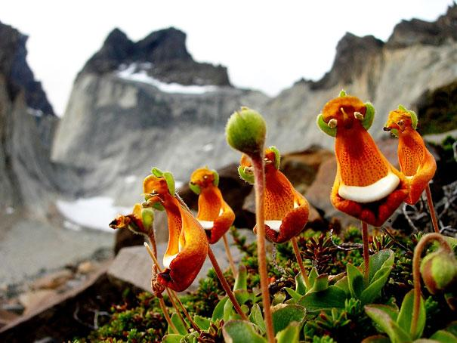
And his friends

Slide 24
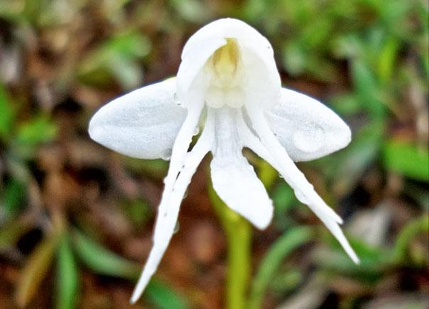
Angel Orchid
(Habenaria Grandifloriformis)

Slide 25
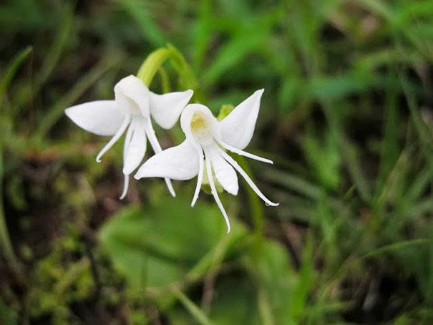

Slide 26
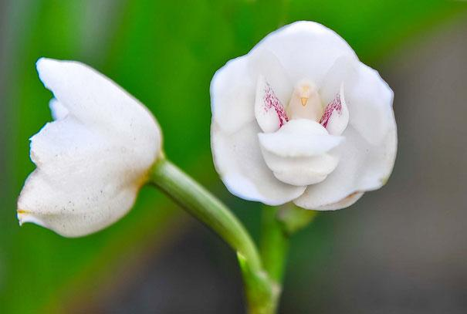
Dove Orchid Or Holy Ghost Orchid (Peristeria Elata)

Slide 27
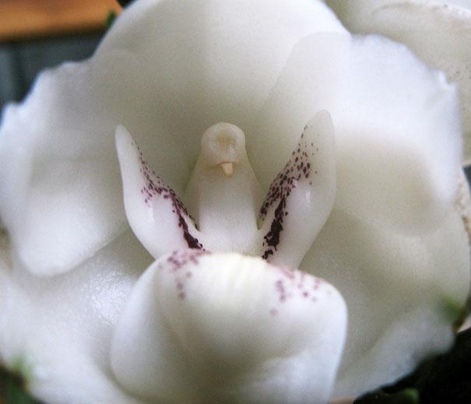

Slide 28
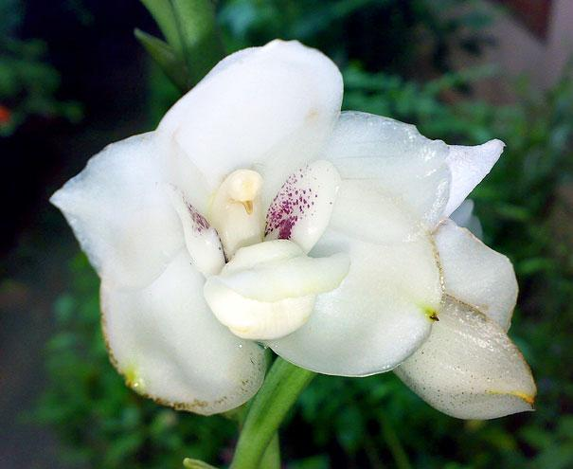

Slide 29
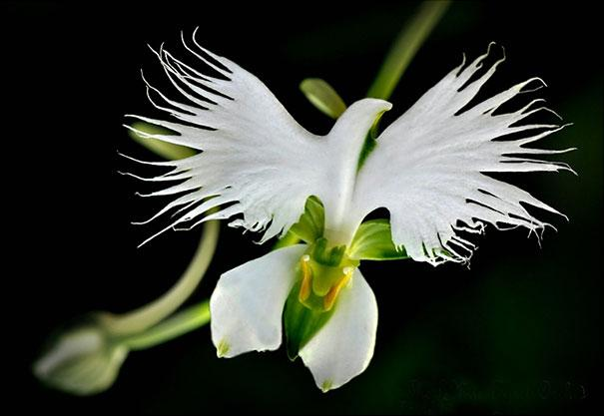
White Egret Orchid
(Habenaria Radiata)

Slide 31
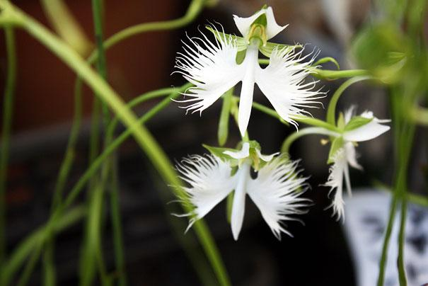

Slide 32
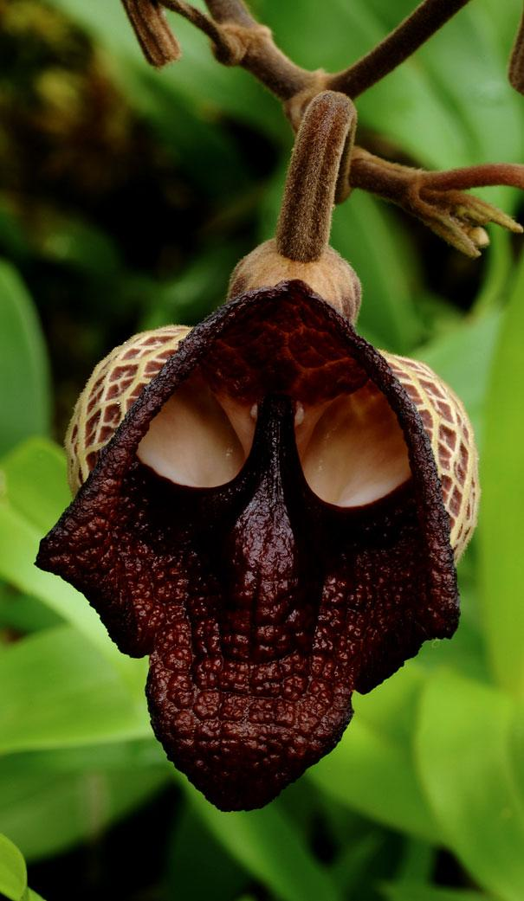
The Darth Vader (Aristolochia Salvadorensis)

Slide 34
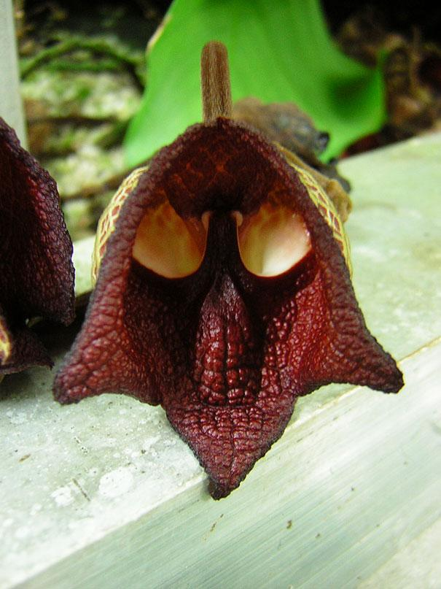

Slide 35
An Orchid That Looks Like A Ballerina

